Slide 1

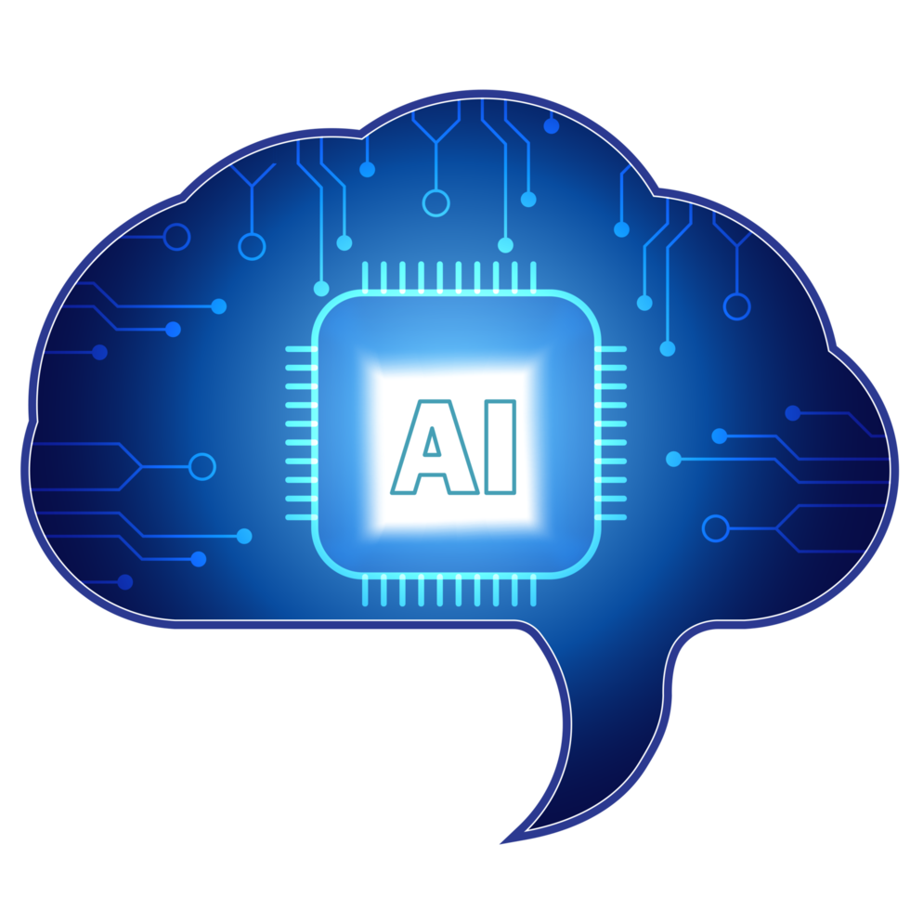
Artificial Intelligence
• What AI means
• Where we meet AI every day
• Benefits and challenges
• What the future may look like
Learn more: IBM AI overview
Notes:
Animation: Apply Fade entrance to title and bullet points. Transition: Fade. Sound: play intro_tone.wav at start.

Slide 2
1. What is AI?
Perception
Recognising images, speech and patterns.
Learning
Improving performance from examples and data.
Reasoning
Using rules or learned patterns to make decisions.
Generative AI
Creating text, images, audio or code.
Notes:
Animation: Use Wipe entrance for the four AI capability bullets. Transition: Push.

Slide 3
2. AI Around Us
• Recommendations
• Navigation & traffic
• Spam and fraud detection
• Face / object recognition
• Personalized learning
Notes:
Animation: Animate chart by series. Transition: Morph or Fade.

Slide 4
3. Benefits & Challenges
Area | Potential benefit | Challenge / caution
Education | Personalized practice and feedback | Over-reliance; inaccurate outputs
Accessibility | Speech, vision and language support | Privacy and consent
Work | Automates repetitive tasks | Job redesign and skills gaps
Creativity | Fast brainstorming and prototyping | Copyright and originality
Notes:
Animation: Animate table rows one by one. Transition: Fade.

Slide 5
4. The Future of AI
• Learn to ask better questions
• Check AI-generated information
• Build digital and data literacy
• Keep humans in important decisions
• Use technology ethically
THANK YOU
Notes:
Animation: Use Zoom/Fade for the future image and bullets. Transition: Fade. Hyperlink is included.

